Slide 1
Data Model
Integrated collection of concepts for describing data, relationships between data, and constraints on the data in an organization.
Data Model comprises:
  a structural part;
  a manipulative part;
  possibly a set of integrity rules.

Slide 2
Data Model
Purpose
  To represent data in an understandable way.
Categories of data models include:
  Object-based
  Record-based
  Physical.

Slide 3
Basic Modeling Concepts
Art and science
Good judgment coupled with powerful design tools
Models
  “Description or analogy used to visualize something that cannot be directly observed” Webster’s Dictionary
  “A model is a representation of the world in simplified terms, it is an abstraction of the real world”
Data Model
  Relatively simple representation of complex real-world data structures

Slide 4
Data Models
Object-Based Data Models
  Entity-Relationship
  Semantic
  Functional
  Object-Oriented.
Record-Based Data Models
  Relational Data Model
  Network Data Model
  Hierarchical Data Model.
Physical Data Models

Slide 5
Entity Relationship (E-R) Modeling

Slide 6
Learning Objectives
How to use Entity–Relationship (ER) modeling in database design.
Basic concepts associated with ER model.
Diagrammatic technique for displaying ER model using Unified Modeling Language (UML).
How to identify and resolve problems with ER models called connection traps.
How to build an ER model from a requirements specification.

Slide 7
Concepts of the ER Model
Entity types
Relationship types
Attributes

Slide 8
Entity Type
Entity type
  Group of objects with same properties, identified by enterprise as having an independent existence.
Entity occurrence
  Uniquely identifiable object of an entity type.

Slide 9
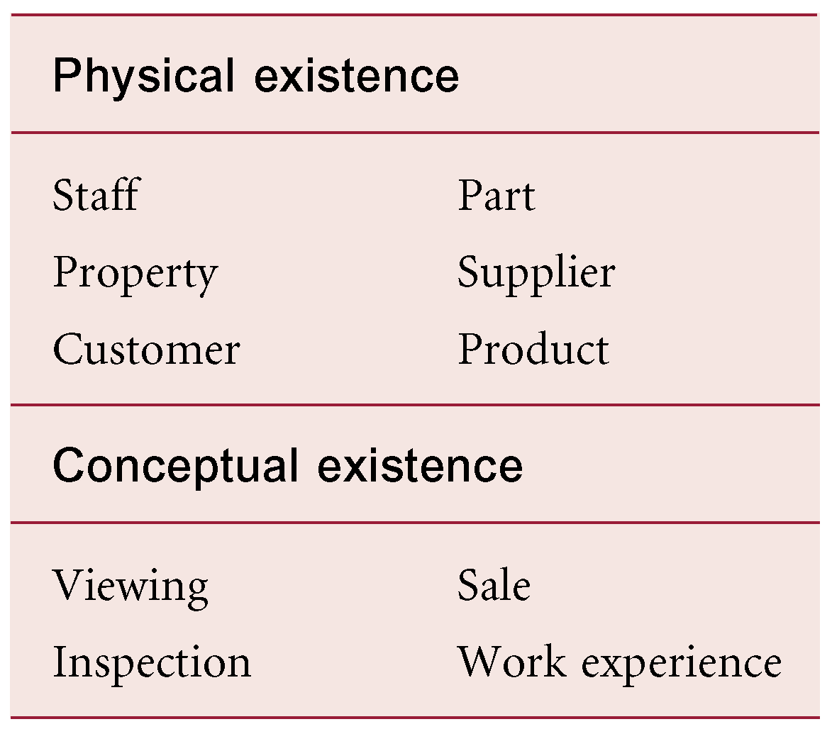
Examples of Entity Types

Slide 10
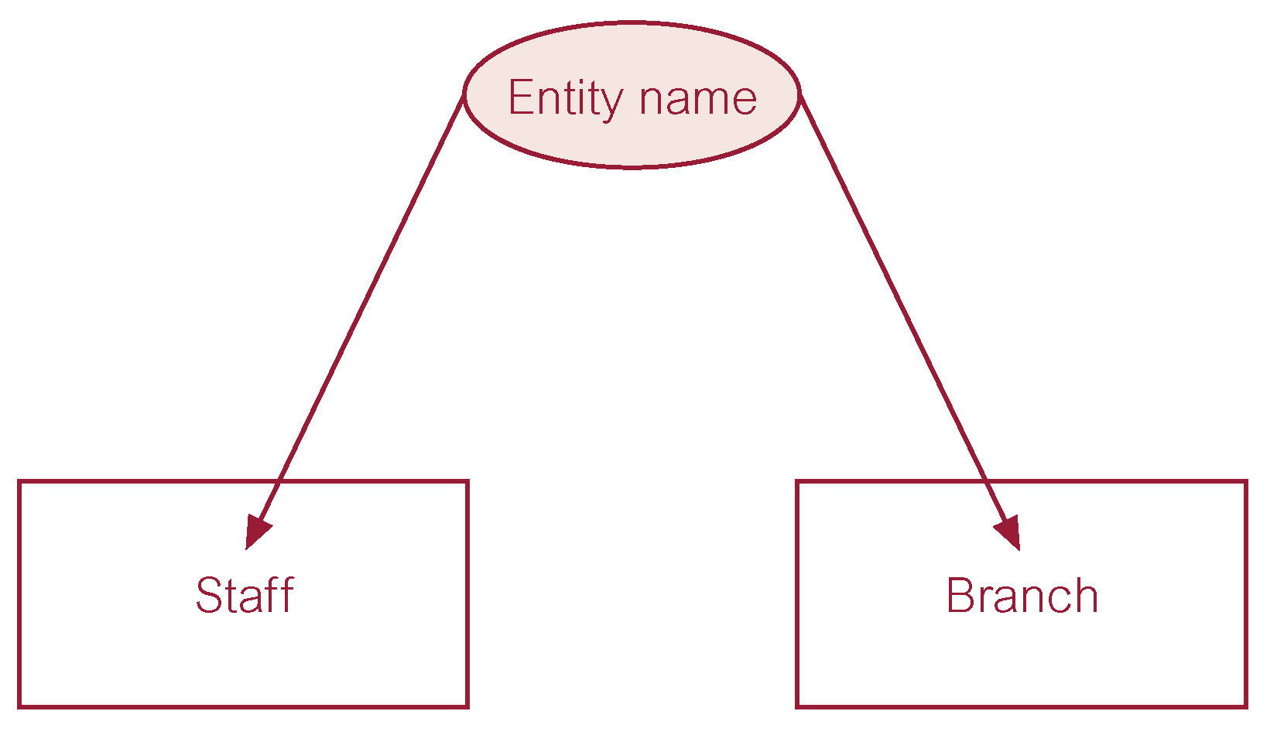
ER Diagram of Staff and Branch Entity Types

Slide 11
Entity Type
Strong Entity Type
  Entity type that is not existence-dependent on some other entity type.
Weak Entity Type
  Entity type that is existence-dependent on some other entity type.

Slide 12
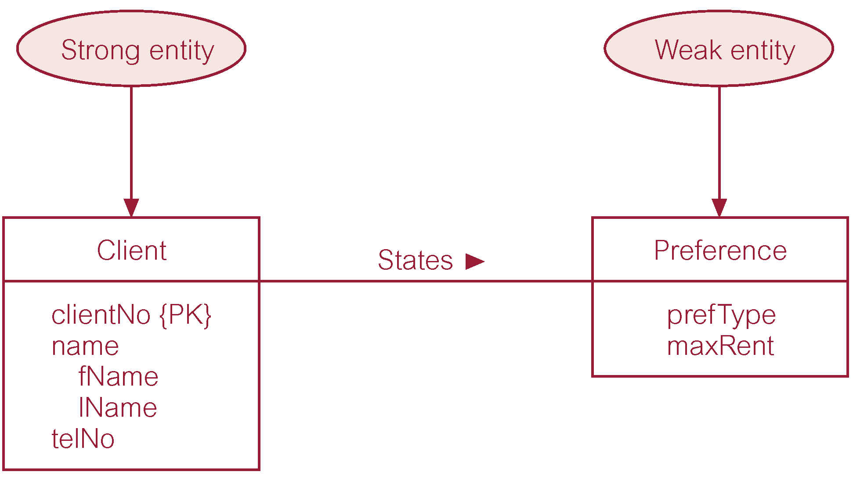
Strong Entity Type called Client and Weak Entity Type called Preference

Slide 13
Relationship Types
Relationship type
  Set of meaningful associations among entity types.
Relationship occurrence
  Uniquely identifiable association, which includes one occurrence from each participating entity type.

Slide 14
Relationship Types
Degree of a Relationship
  Number of participating entities in relationship.
Relationship of degree:
  two is binary;
  three is ternary;
  four is quaternary.

Slide 15
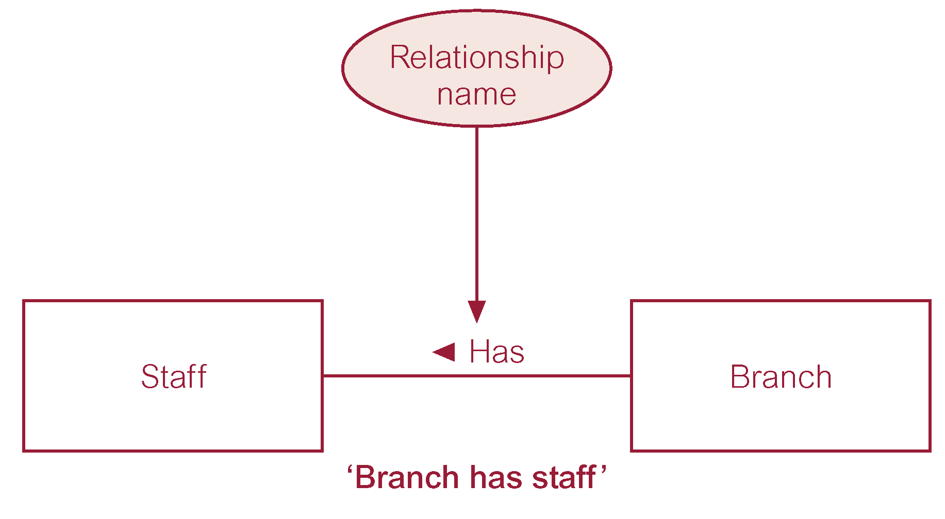
ER Diagram of Branch Has Staff Relationship

Slide 16
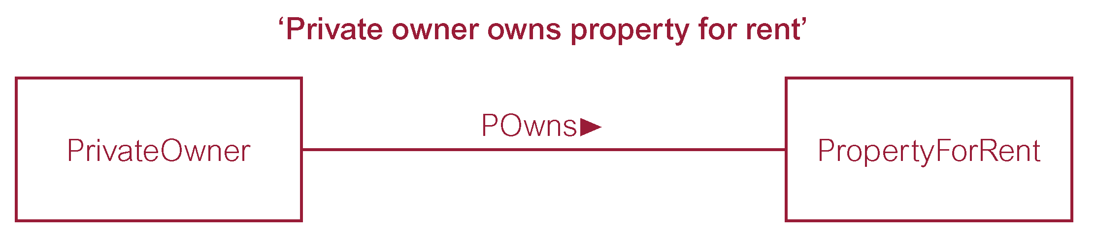
Binary Relationship called POwns

Slide 17
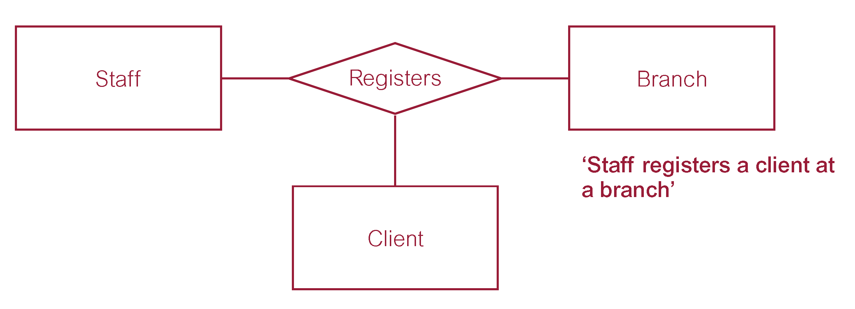
Ternary Relationship called Registers

Slide 18
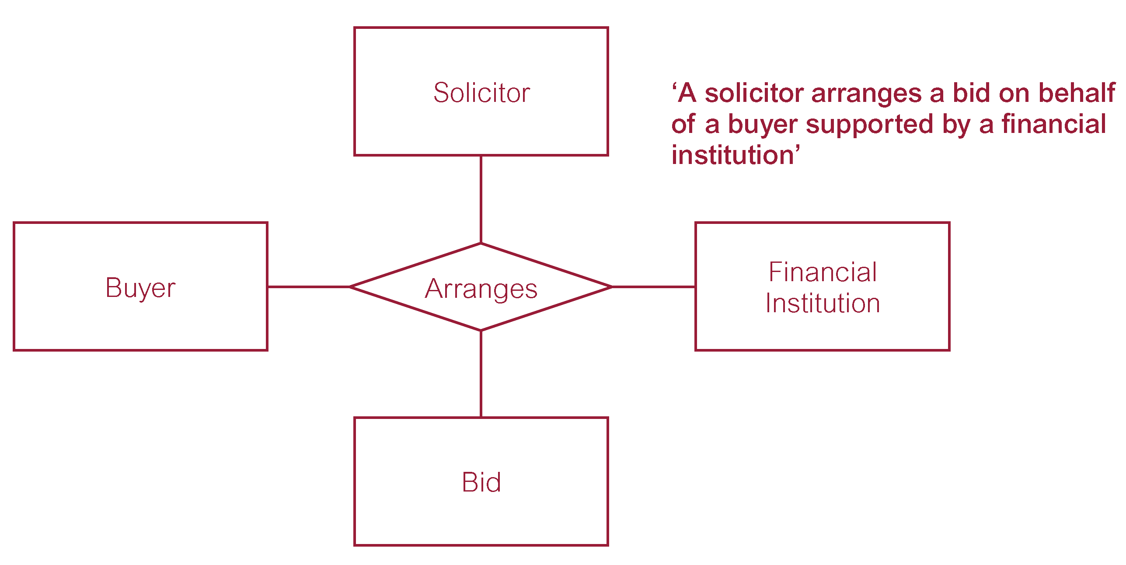
Quaternary Relationship called Arranges

Slide 19
Relationship Types
Recursive Relationship
  Relationship type where same entity type participates more than once in different roles.
Relationships may be given role names to indicate purpose that each participating entity type plays in a relationship.

Slide 20
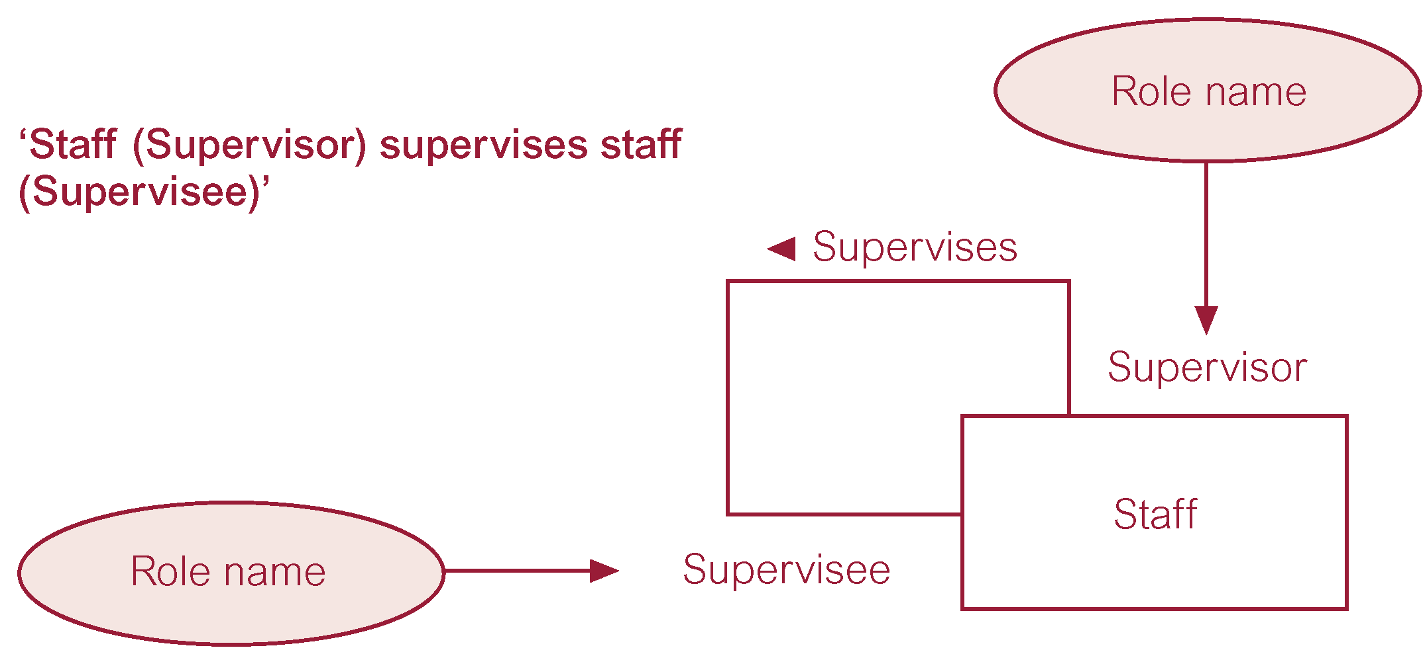
Recursive Relationship called Supervises with Role Names

Slide 21
Attributes
Attribute
  Property of an entity or a relationship type.
Attribute Domain
  Set of allowable values for one or more attributes.

Slide 22
Attributes
Simple Attribute
  Attribute composed of a single component with an independent existence.
Composite Attribute
  Attribute composed of multiple components, each with an independent existence.

Slide 23
Attributes
Single-valued Attribute
  Attribute that holds a single value for each occurrence of an entity type.
Multi-valued Attribute
  Attribute that holds multiple values for each occurrence of an entity type.

Slide 24
Attributes
Derived Attribute
  Attribute that represents a value that is derivable from value of a related attribute, or set of attributes, not necessarily in the same entity type.

Slide 25
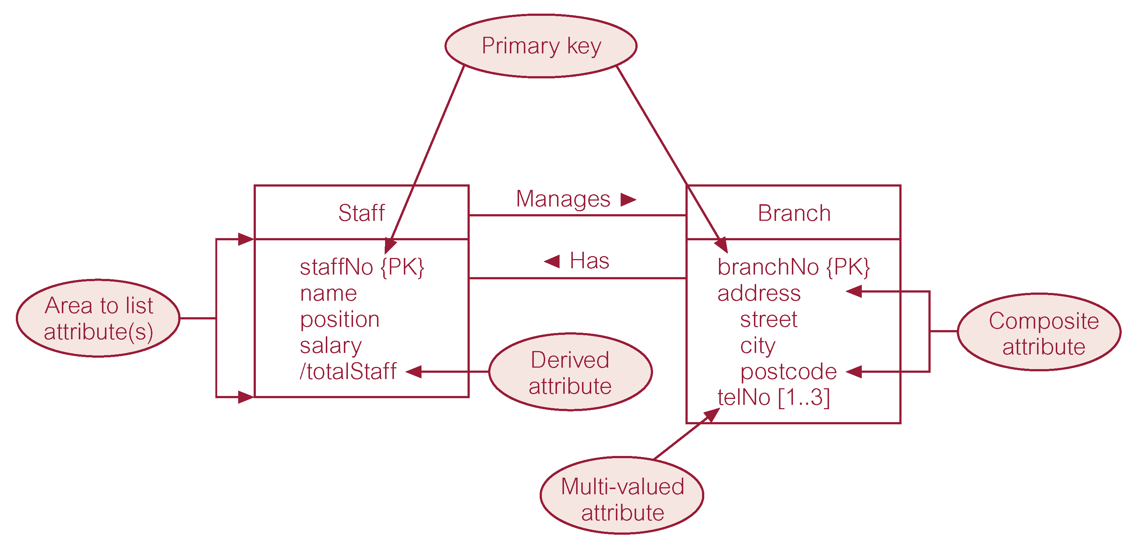
ER Diagram of Staff and Branch Entities and their Attributes

Slide 26
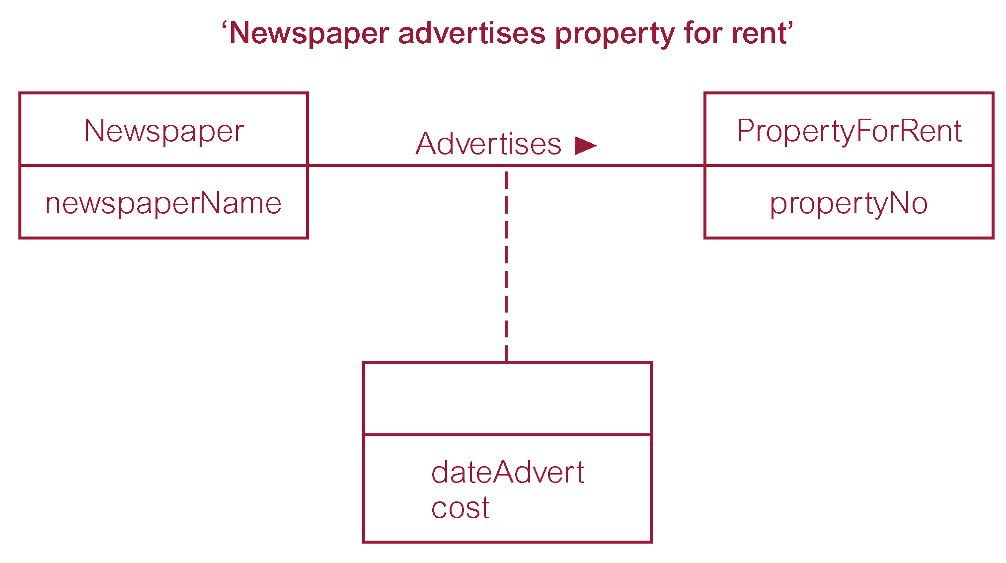
Relationship called Advertises with Attributes

Slide 27
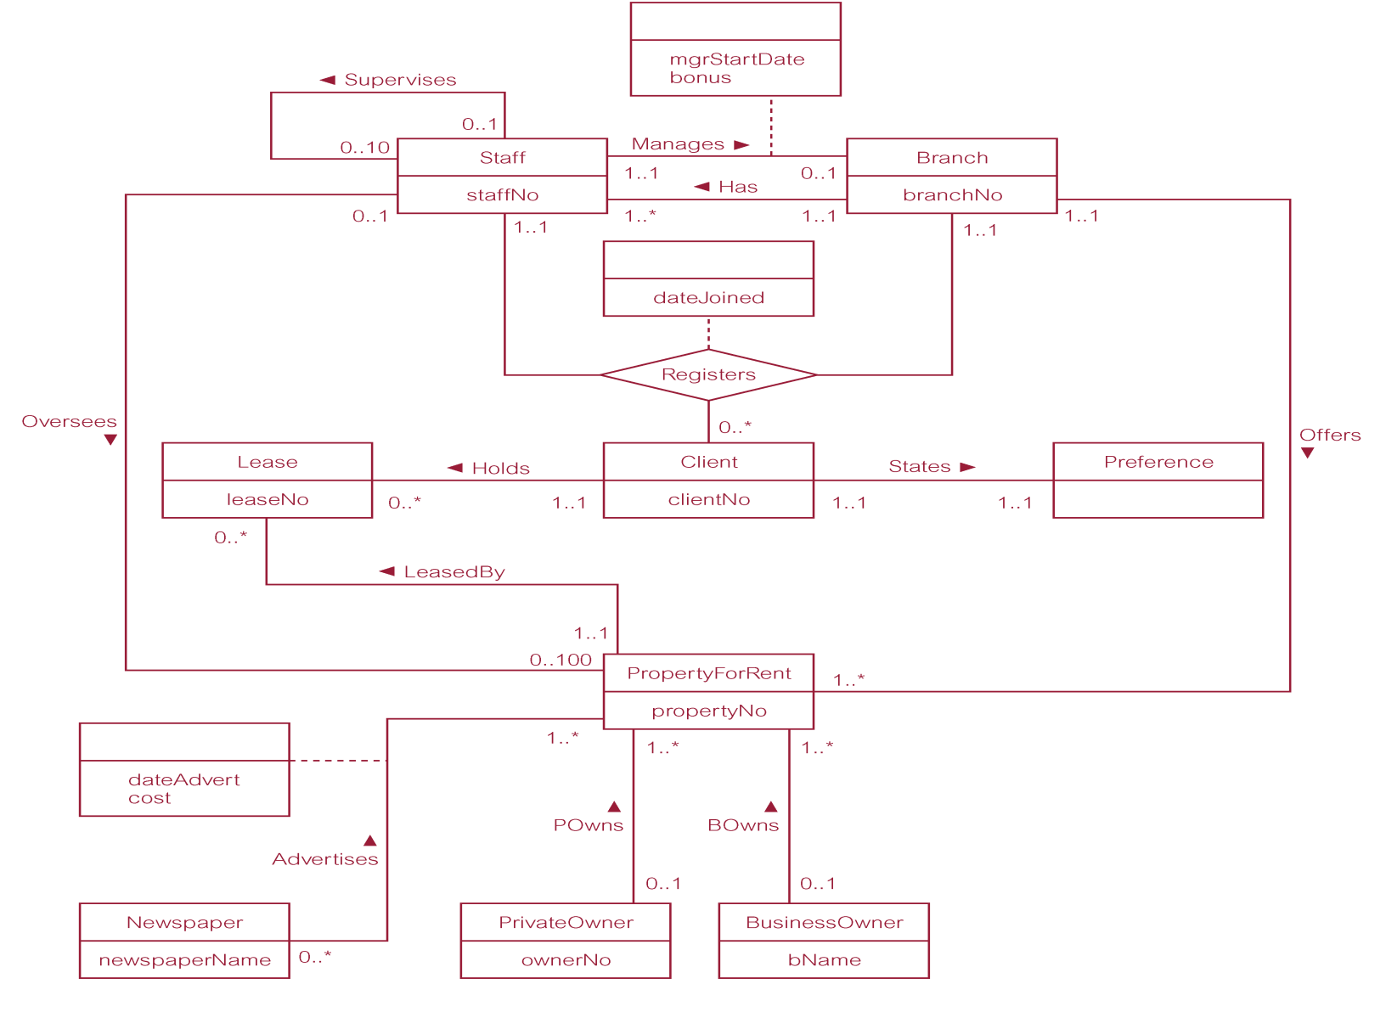
ER Diagram of Branch View of DreamHome

Slide 28
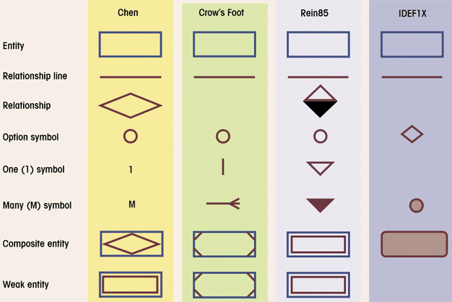
Comparison of E-R Modeling Symbols

Slide 29
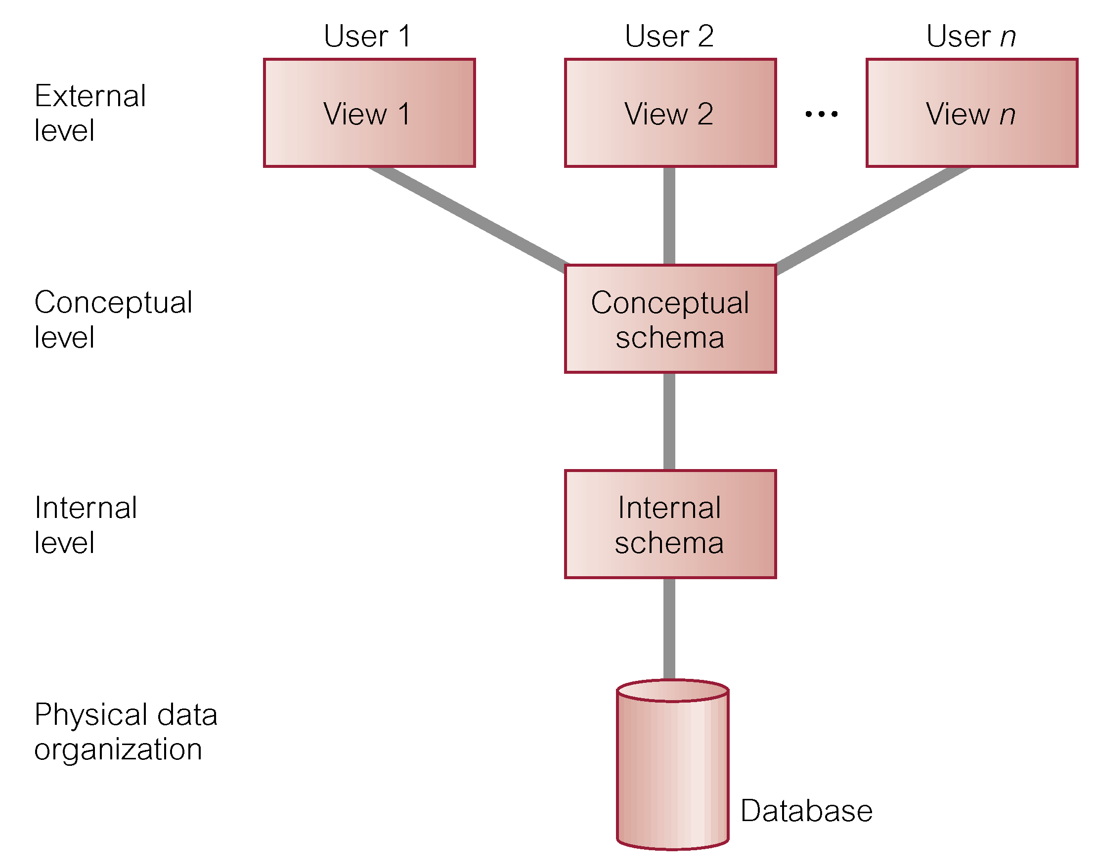
ANSI-SPARC
Three-Level Architecture

Slide 30
Degrees of Abstraction
Conceptual
  Global view of data from application domain, based on end-users requirements
  Basis for identification and description of main data items
  ERD used to graphically represent conceptual data model (or class diagram in UML)
  Hardware and software (and DBMS) independent
Internal
  Representation of database as seen by DBMS
  Adapts conceptual model to a specific DBMS
  Software dependent

Slide 31
Degrees of Abstraction
External
  Users’ views of data environment
  Provides subsets of internal view
  Makes application program development easier
  Facilitates designers’ tasks
  Ensures adequacy of conceptual model
  Ensures security constraints in design
Physical
  Lowest level of abstraction
  Software and hardware dependent
  Requires definition of physical storage devices and access methods

Slide 32
Degrees of Abstraction
Three main levels of data models: deliverables
  Conceptual data model
    Project initiation and planning: ERD’s with entities and relationships only
    Analysis: ERD’s refined with attributes
  Logical data model = Internal + external data model: a set of normalized relations, based on ERD and views/forms design
  Physical data model = physical file and database design

Slide 33
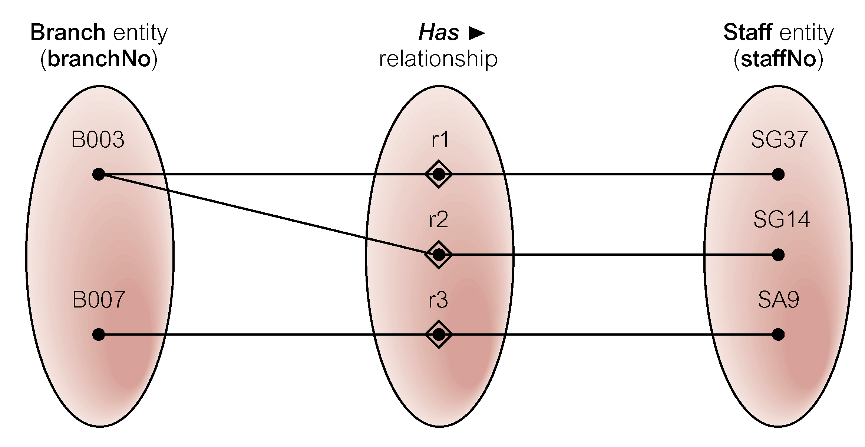
Semantic Net of Has Relationship Type

Slide 34
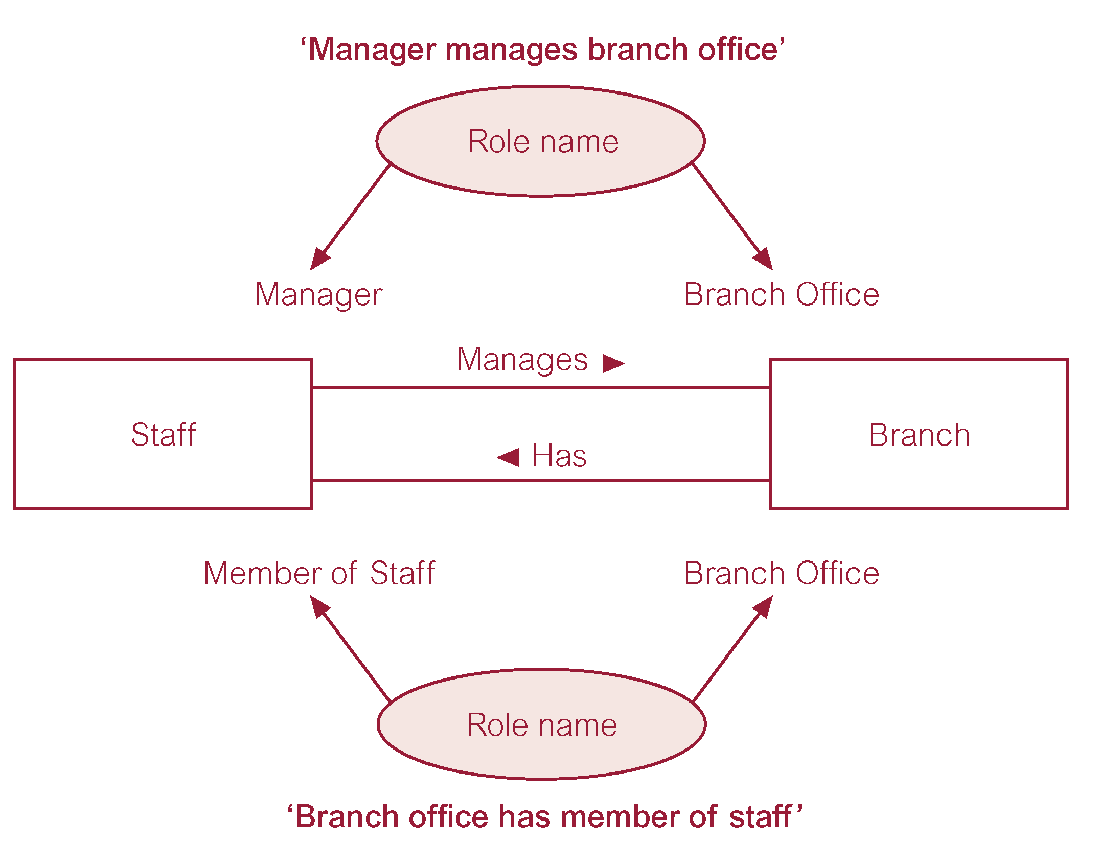
Entities associated through two distinct Relationships with Role Names

Slide 35
Keys
Candidate Key
  Minimal set of attributes that uniquely identifies each occurrence of an entity type.
Primary Key
  Candidate key selected to uniquely identify each occurrence of an entity type.
Composite Key
  A candidate key that consists of two or more attributes.

Slide 36
Structural Constraints
Main type of constraint on relationships is called multiplicity.
Multiplicity - number (or range) of possible occurrences of an entity type that may relate to a single occurrence of an associated entity type through a particular relationship.
Represents policies (called business rules) established by user or company.

Slide 37
Structural Constraints
The most common degree for relationships is binary.
Binary relationships are generally referred to as being:
  one-to-one (1:1)
  one-to-many (1:*)
  many-to-many (*:*)

Slide 38
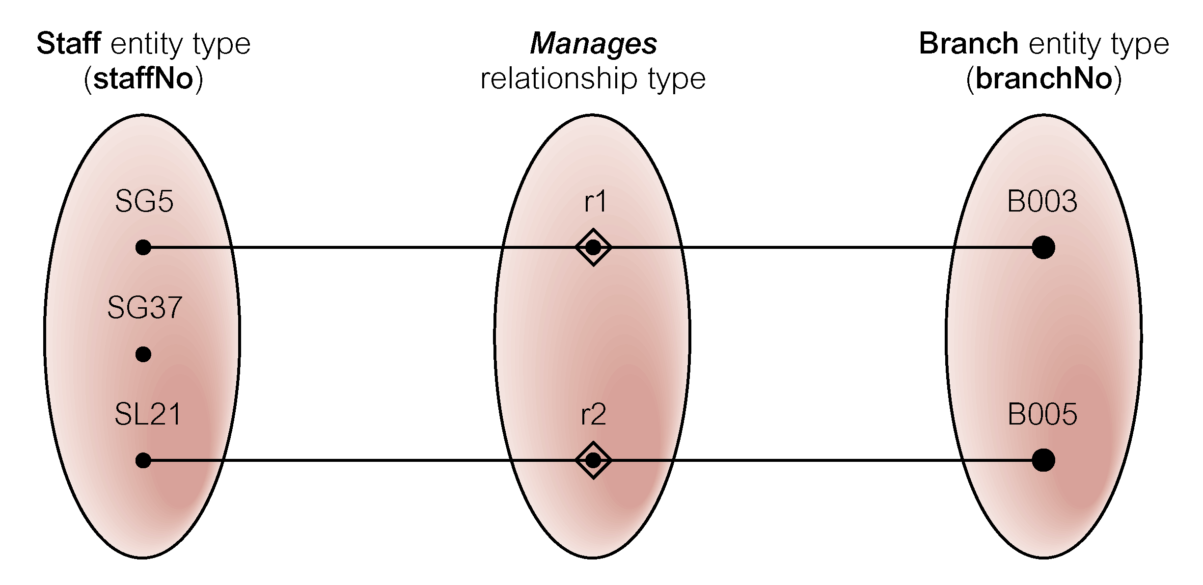
Semantic Net of Staff Manages Branch Relationship Type

Slide 39
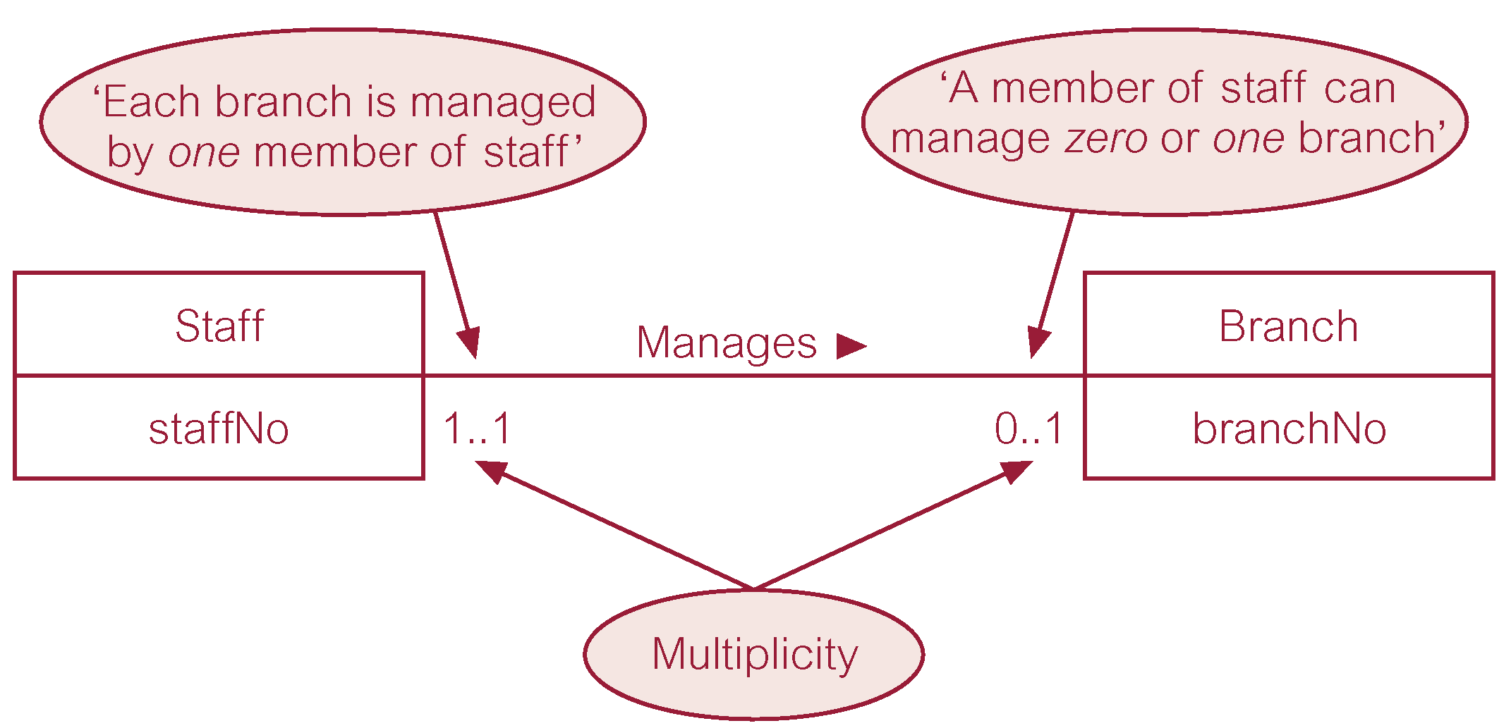
Multiplicity of Staff Manages Branch (1:1) Relationship Type

Slide 40
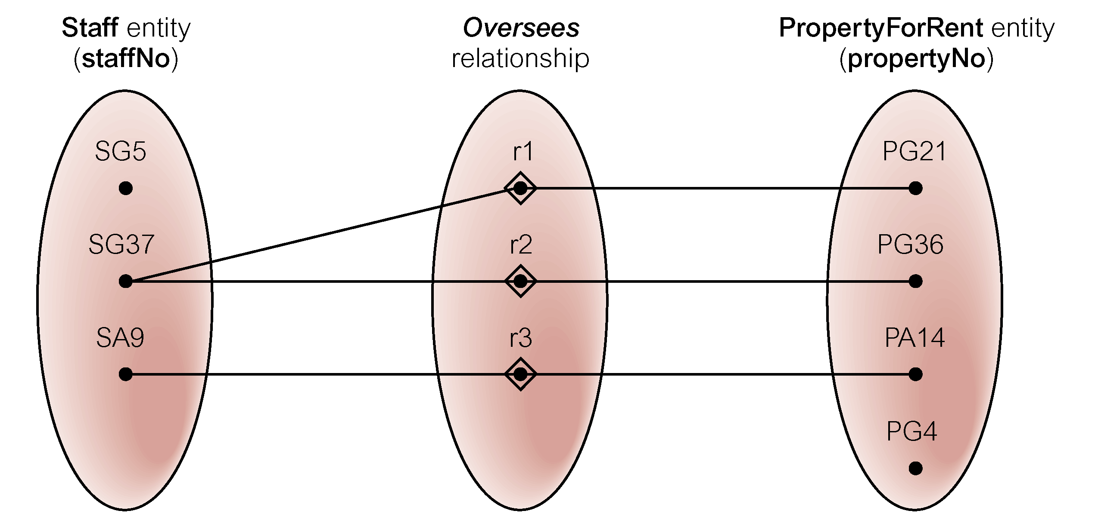
Semantic Net of Staff Oversees PropertyForRent Relationship Type

Slide 41
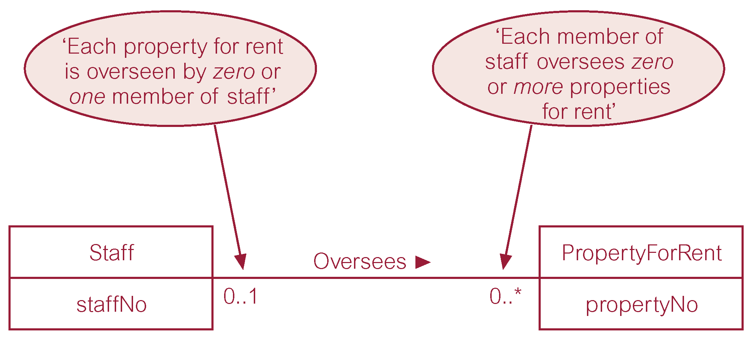
Multiplicity of Staff Oversees PropertyForRent (1:*) Relationship Type

Slide 42
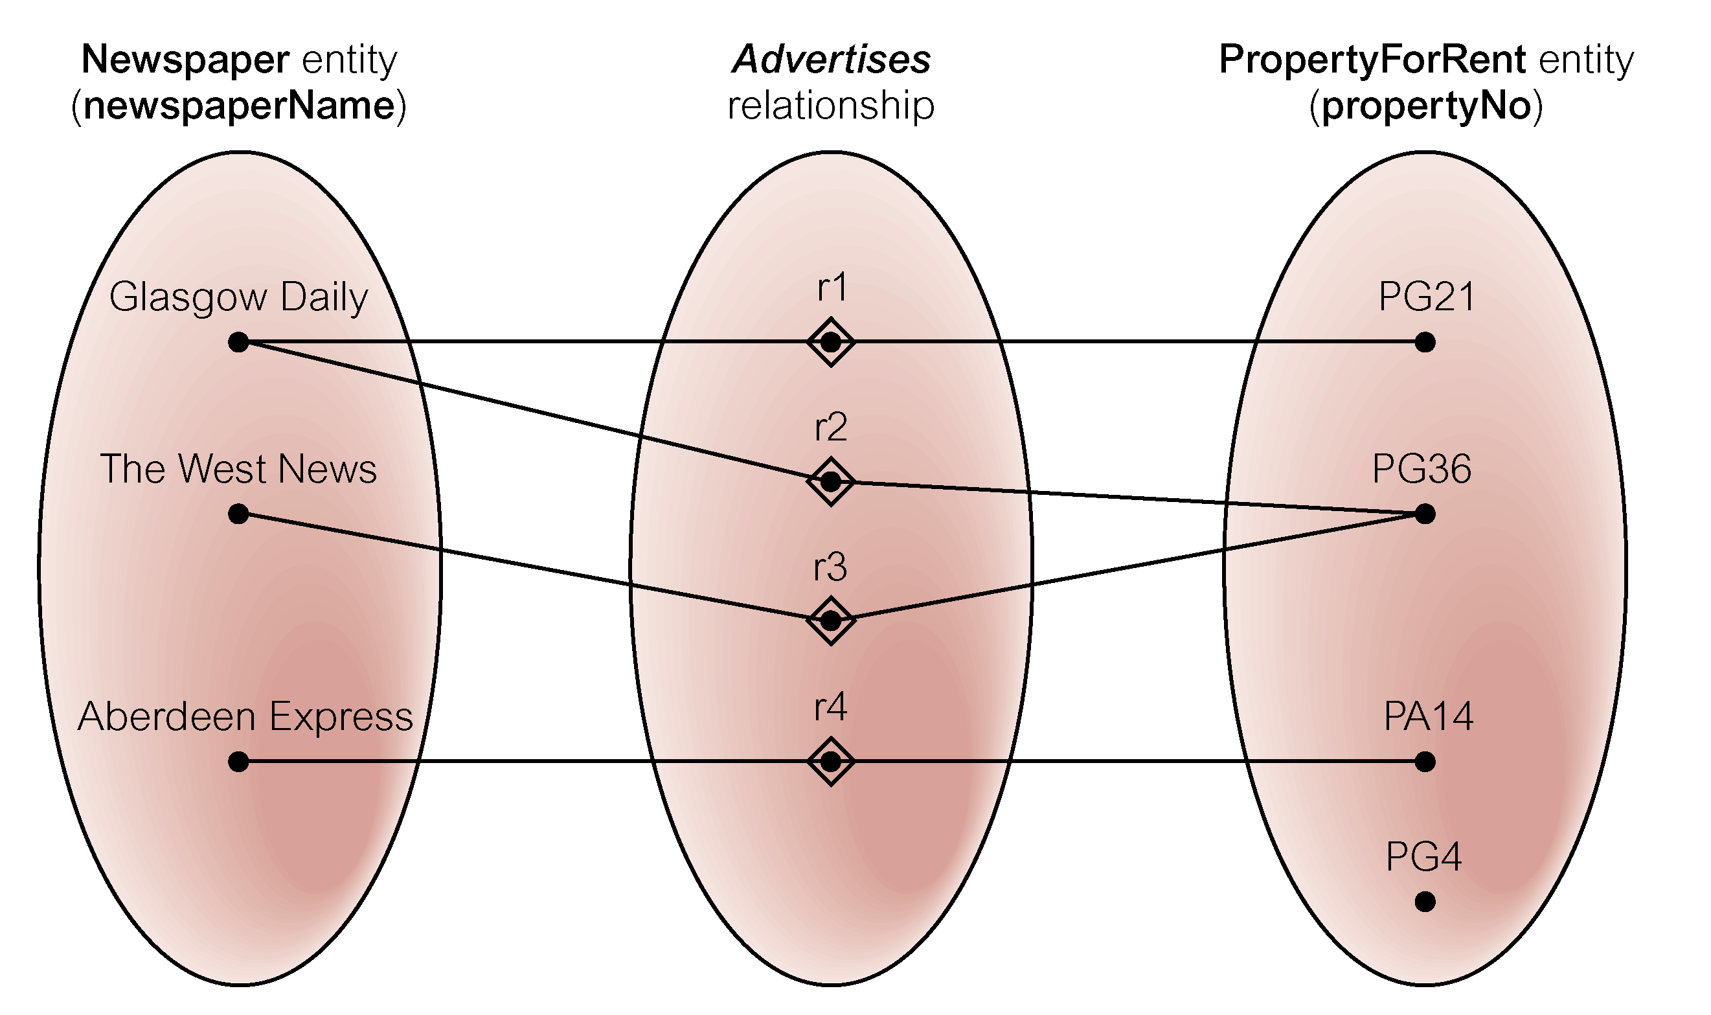
Semantic Net of Newspaper Advertises PropertyForRent Relationship Type

Slide 43
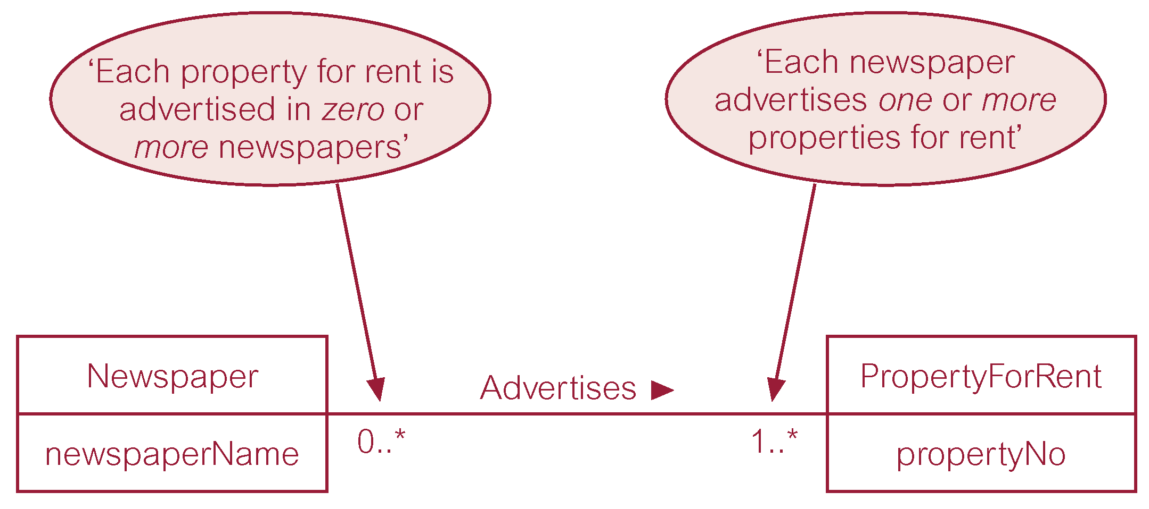
Multiplicity of Newspaper Advertises PropertyForRent (*:*) Relationship

Slide 44
Structural Constraints
Multiplicity for Complex Relationships
  Number (or range) of possible occurrences of an entity type in an n-ary relationship when other (n-1) values are fixed.

Slide 45
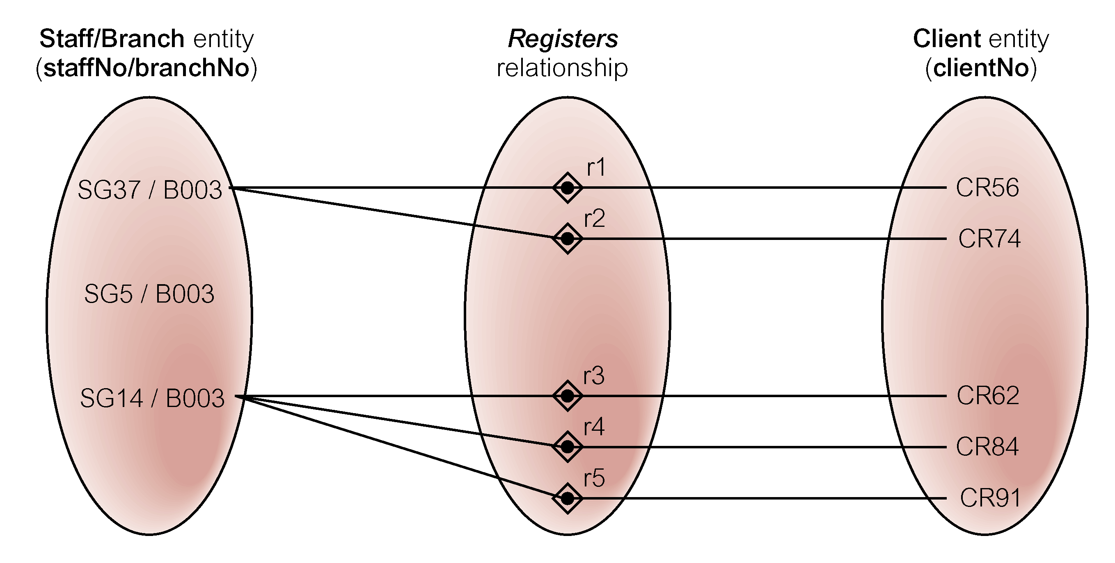
Semantic Net of Ternary Registers Relationship with Values for Staff and Branch Entities Fixed

Slide 46
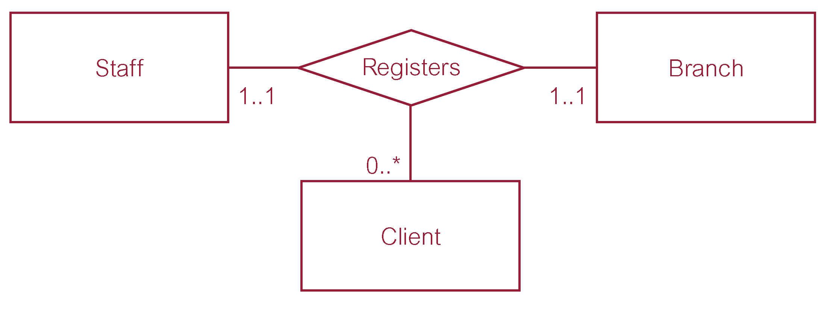
Multiplicity of Ternary Registers Relationship

Slide 47
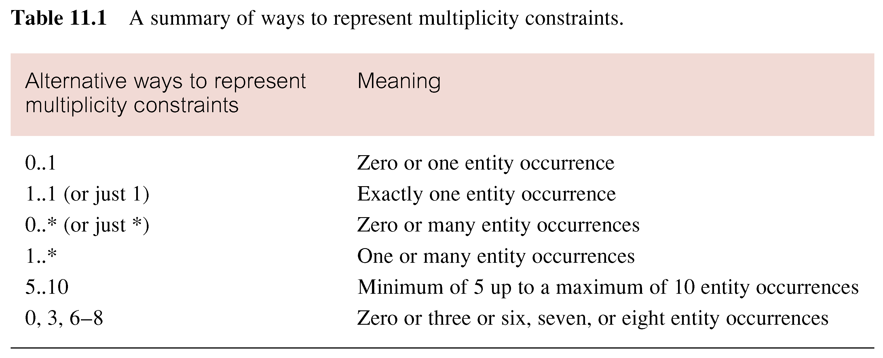
Summary of Multiplicity Constraints

Slide 48
Structural Constraints
Multiplicity is made up of two types of restrictions on relationships: cardinality and participation.
Cardinality
  Describes maximum number of possible relationship occurrences for an entity participating in a given relationship type (1,4), (1,N) ...
Participation
  Determines whether all or only some entity occurrences participate in a relationship (optional/mandatory).

Slide 49
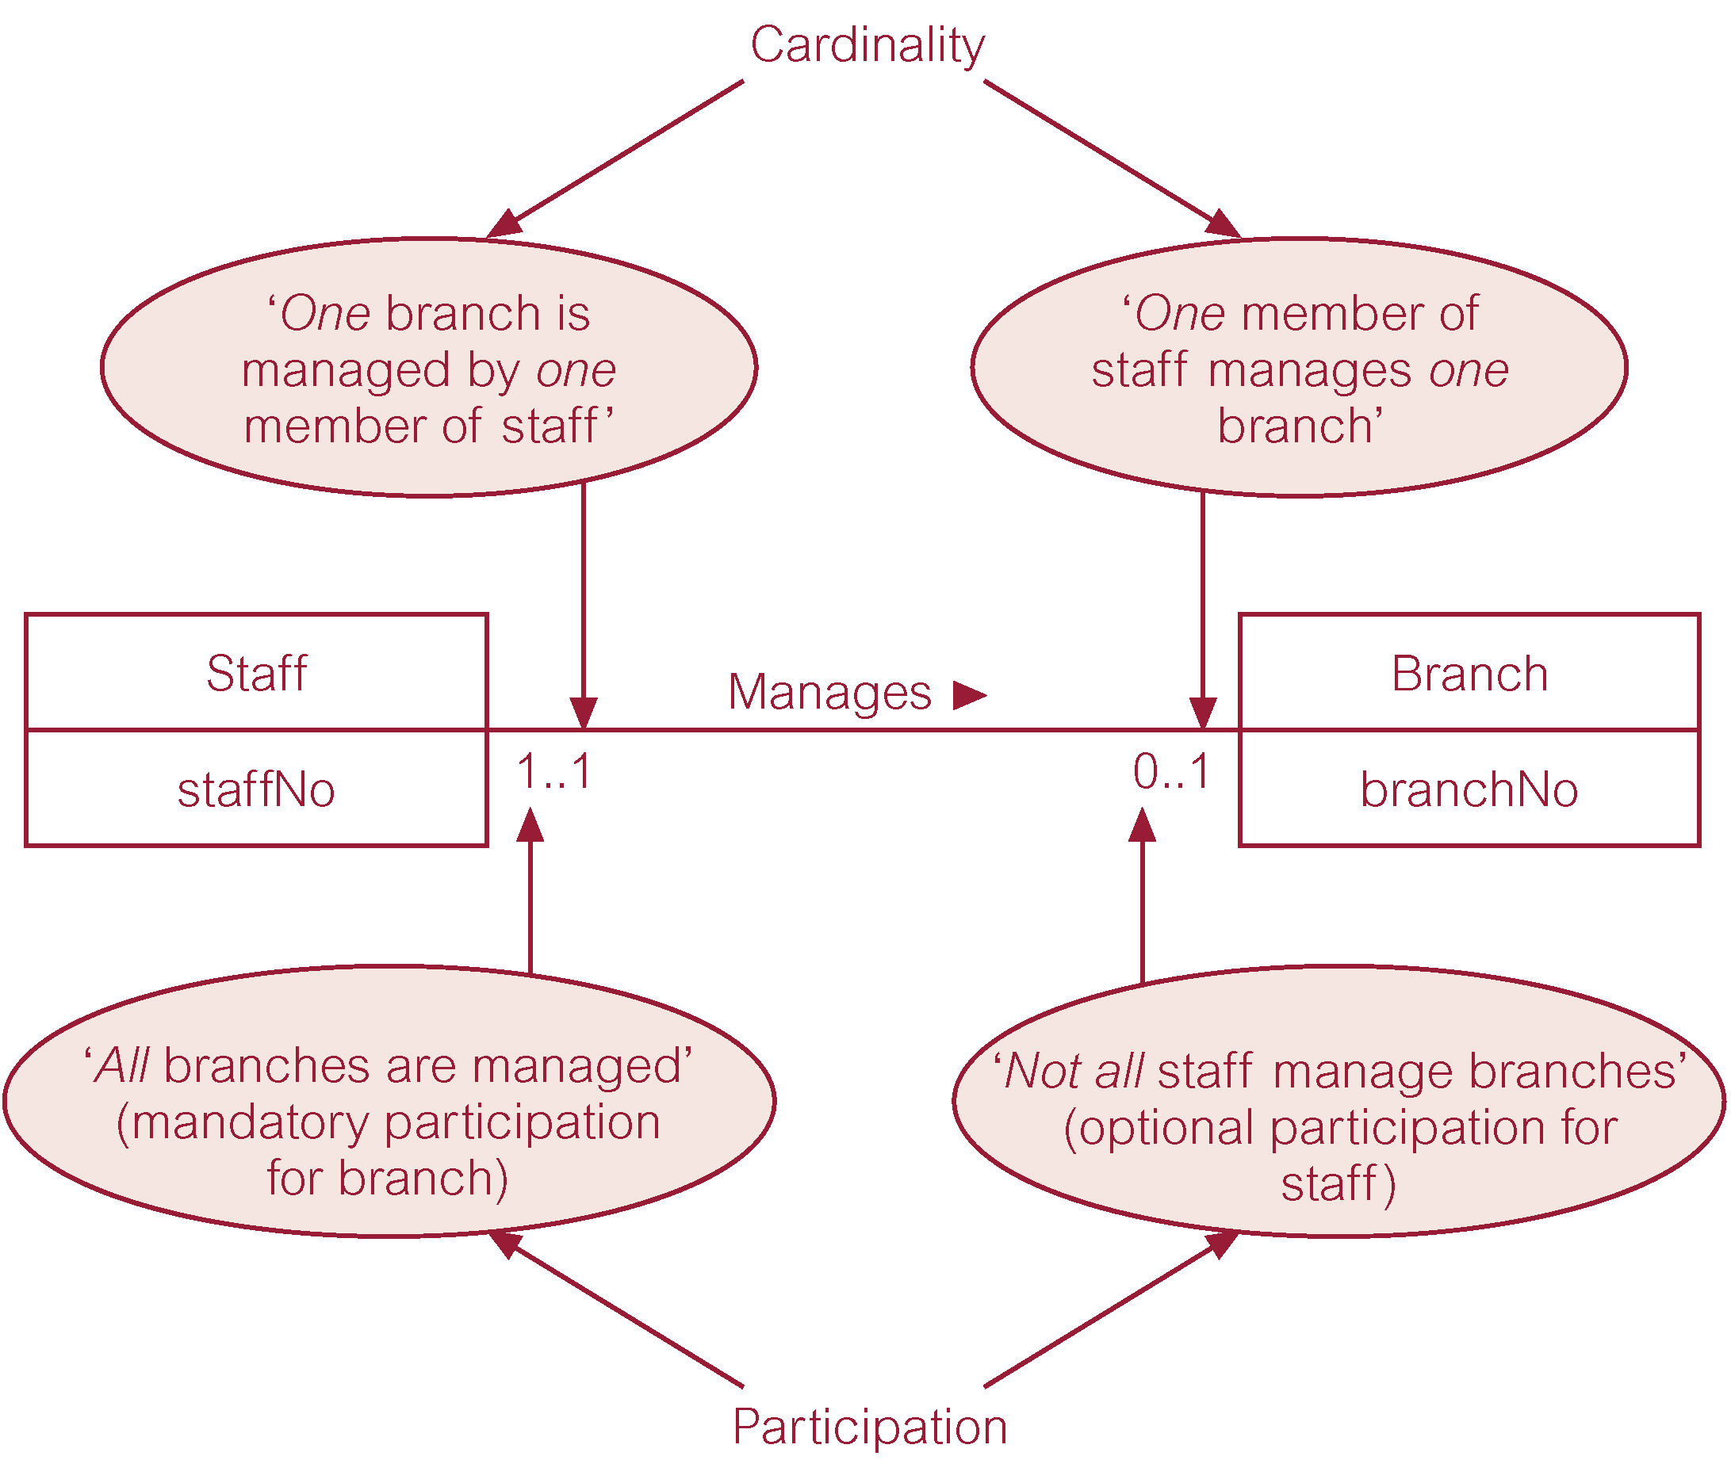
Multiplicity as Cardinality and Participation Constraints

Slide 50
Problems with ER Models
Problems may arise when designing a conceptual data model called connection traps.
Often due to a misinterpretation of the meaning of certain relationships.
Two main types of connection traps are called fan traps and chasm traps.

Slide 51
Problems with ER Models
Fan Trap
  Where a model represents a relationship between entity types, but pathway between certain entity occurrences is ambiguous.
Chasm Trap
  Where a model suggests the existence of a relationship between entity types, but pathway does not exist between certain entity occurrences.

Slide 52

An Example of a Fan Trap

Slide 53
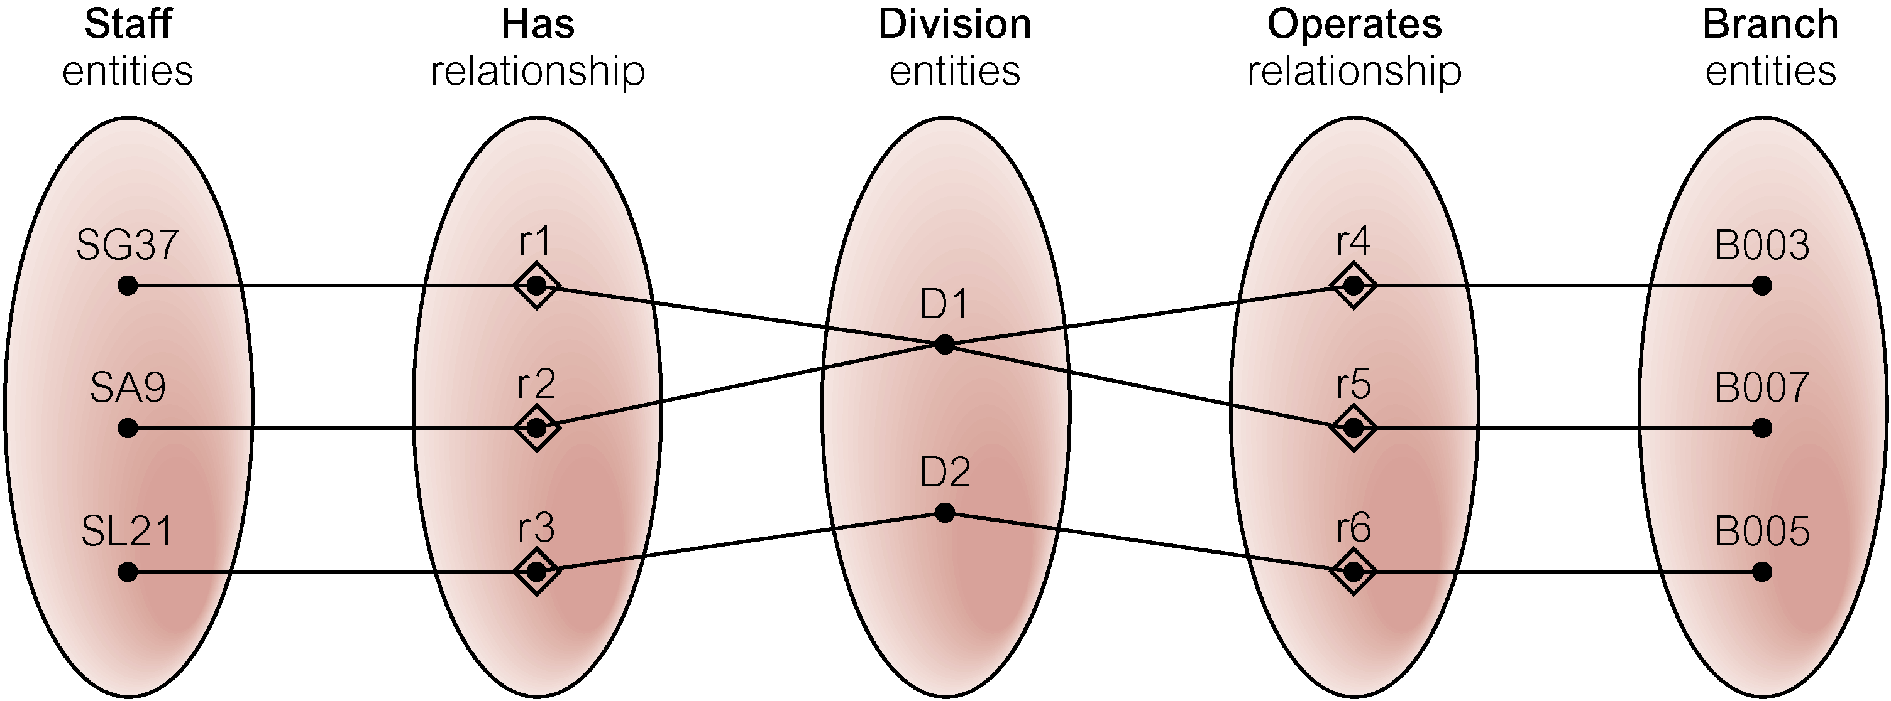
Semantic Net of ER Model with Fan Trap
At which branch office does staff number SG37 work?

Slide 54
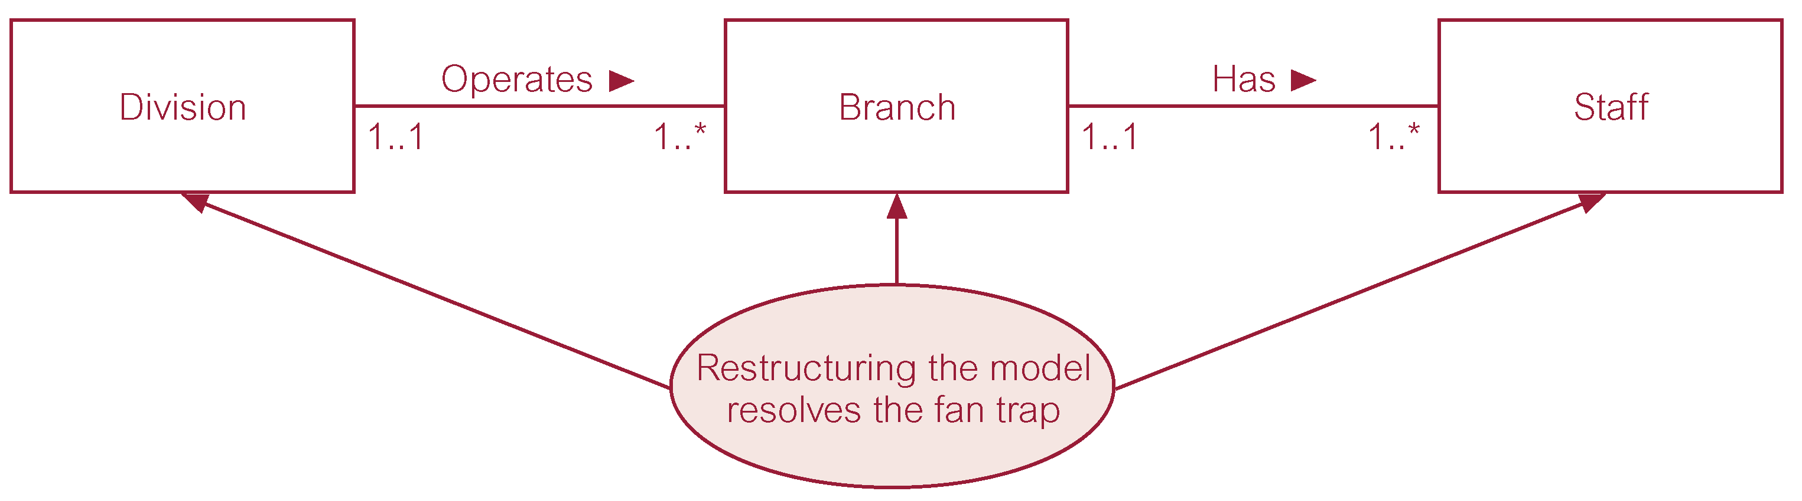
Restructuring ER Model to Remove Fan Trap

Slide 55
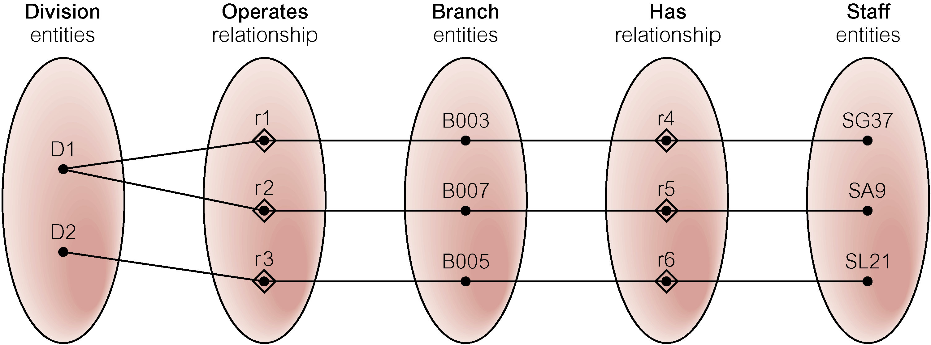
Semantic Net of Restructured ER Model with Fan Trap Removed
SG37 works at branch B003.

Slide 56

An Example of a Chasm Trap

Slide 57
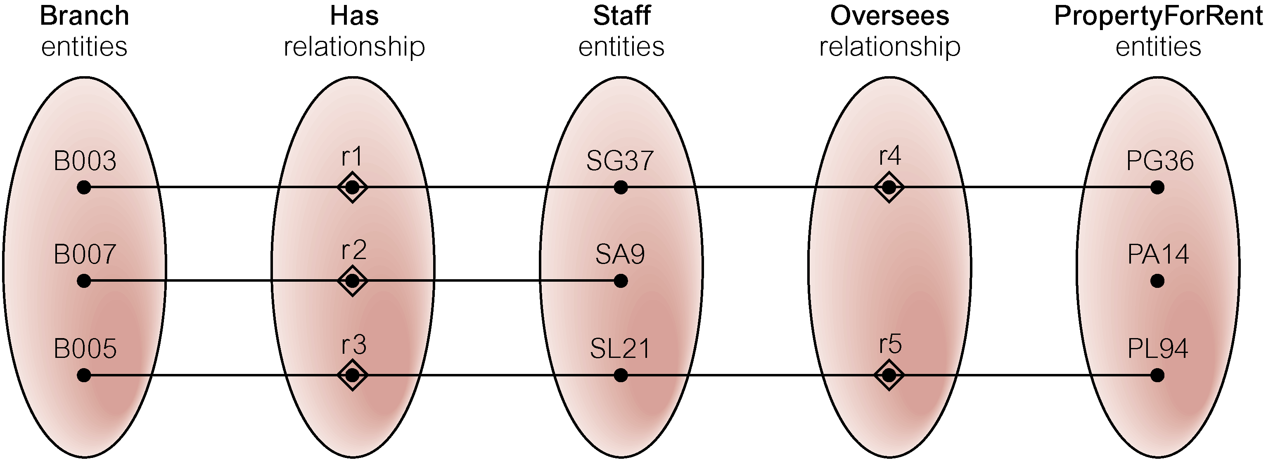
Semantic Net of ER Model with Chasm Trap
At which branch office is property PA14 available?

Slide 58
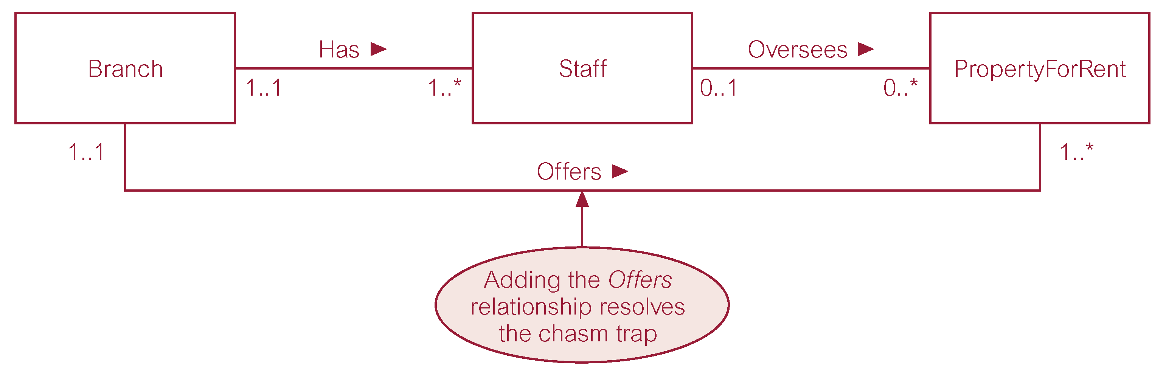
ER Model Restructured to Remove Chasm Trap

Slide 59
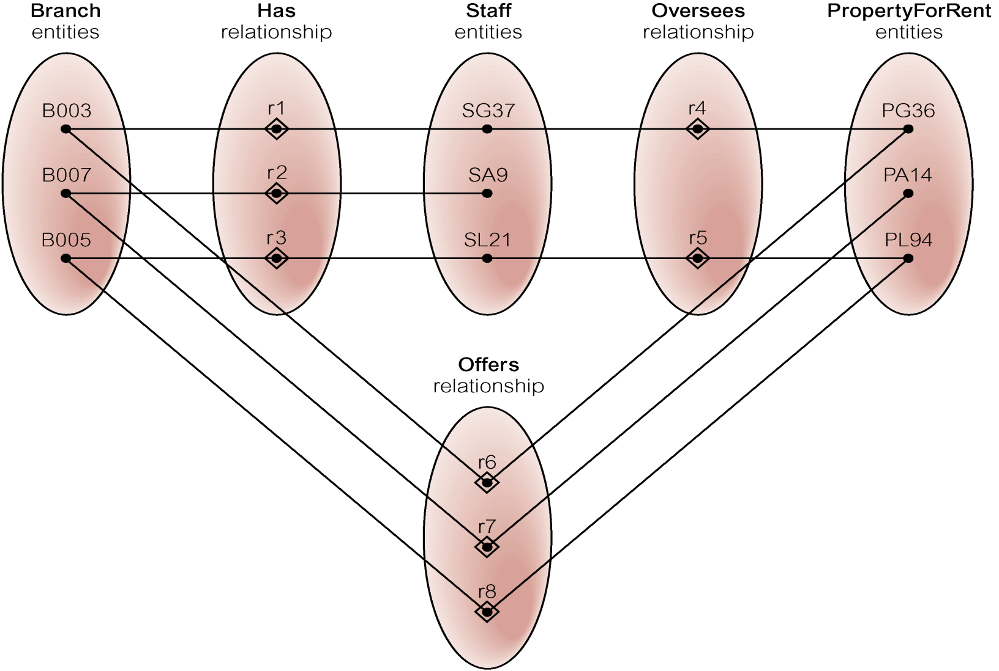
Semantic Net of Restructured ER Model with Chasm Trap Removed

Slide 60
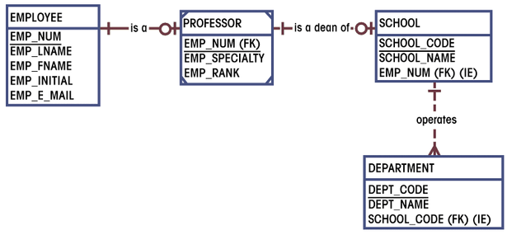
First ERD Segment Established
Figure 3.43

Slide 61
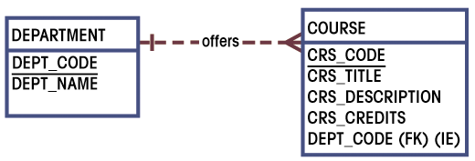
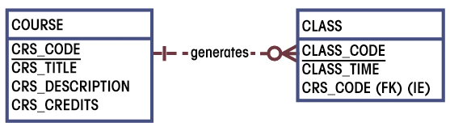
Second and Third ERD
Segments Established

Slide 62
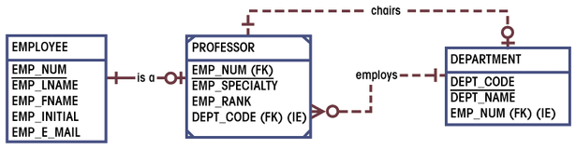
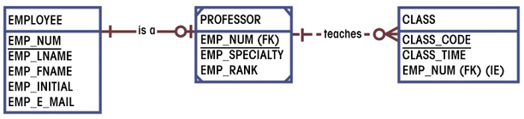
Fourth and Fifth ERD
Segments Established

Slide 63
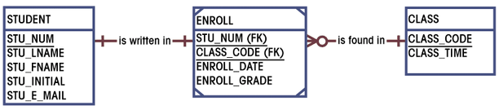
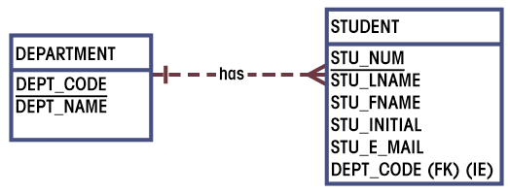
Sixth and Seventh ERD
Segments Established

Slide 64
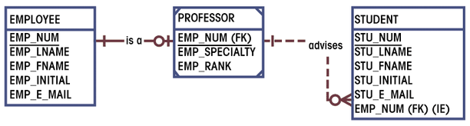
Eighth ERD
Segment Established

Slide 65
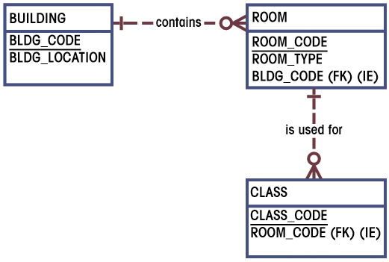
Ninth ERD
Segment Established
Figures 3.51

Slide 66
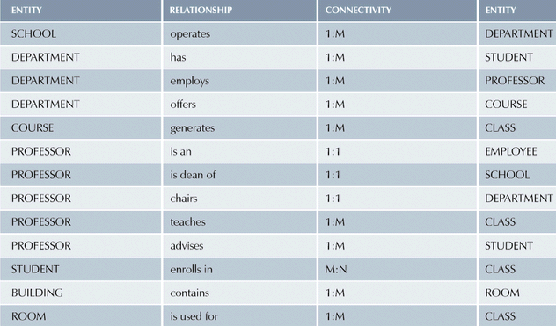
Components of E-R Model

Slide 67
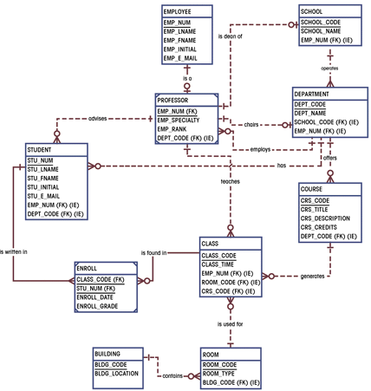
Completed ERD

Slide 68
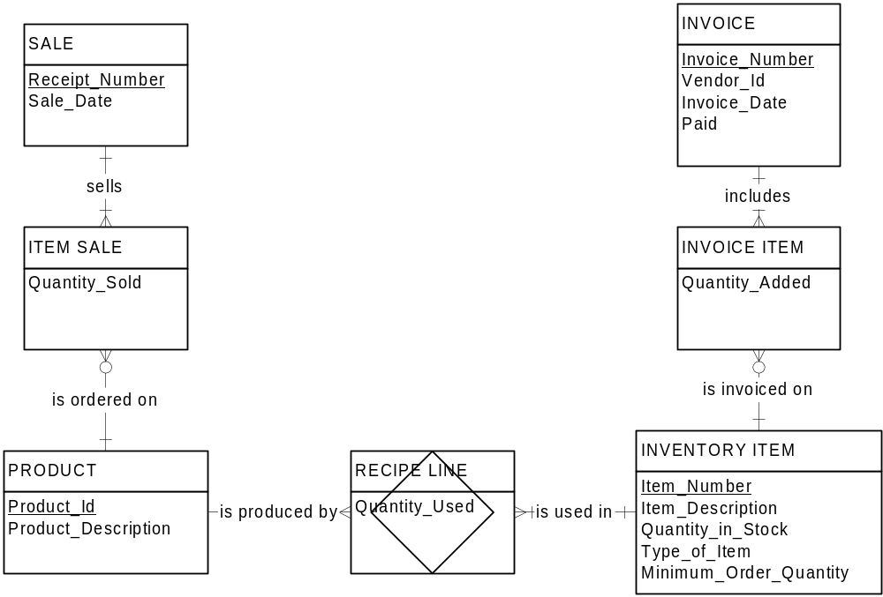
Burger Inventory Example

